Slide 1
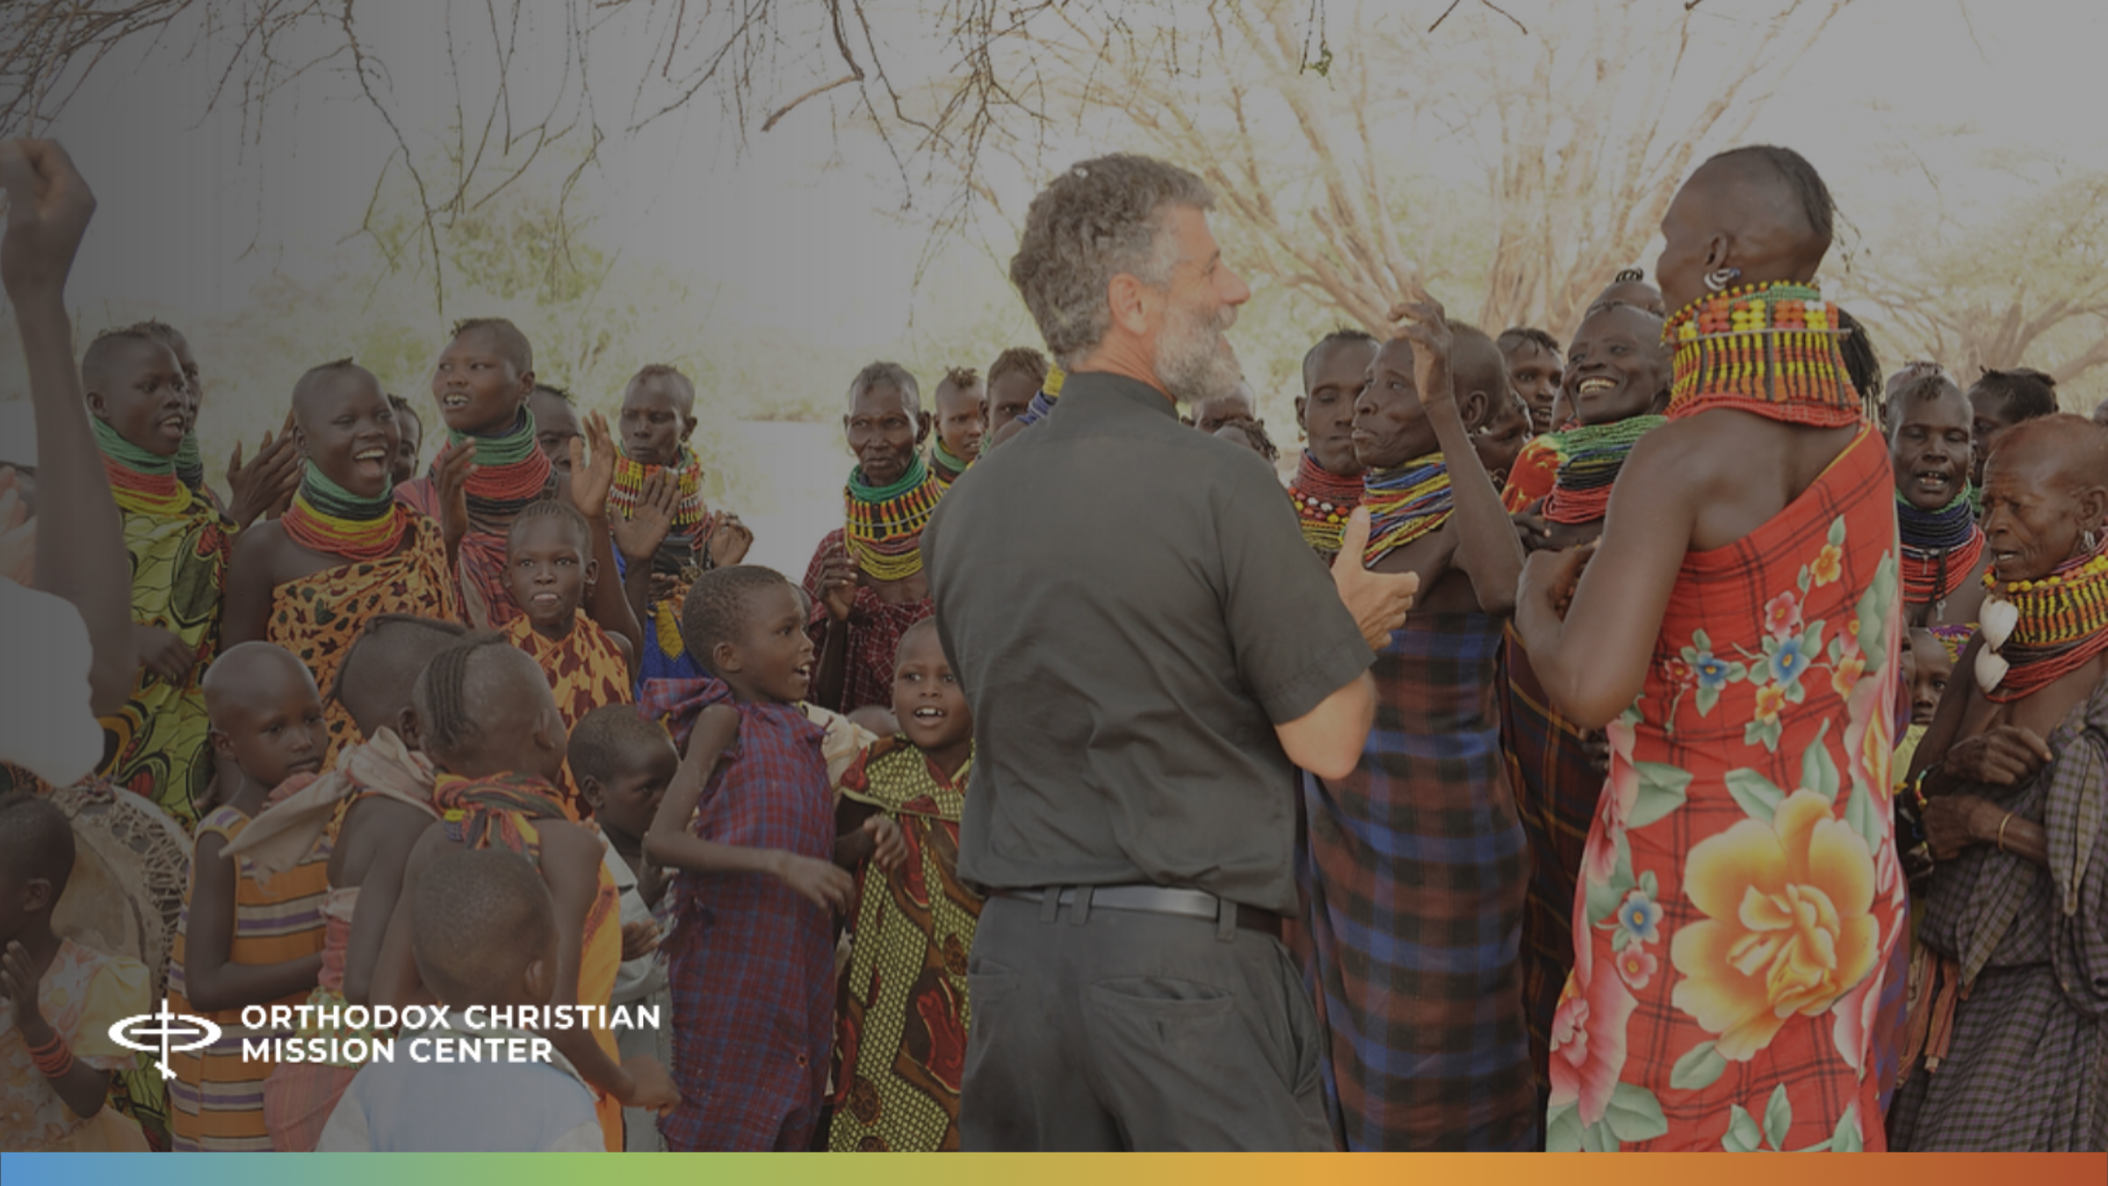
Orthodoxy in Turkana:
Mission Sunday 2025

Slide 2
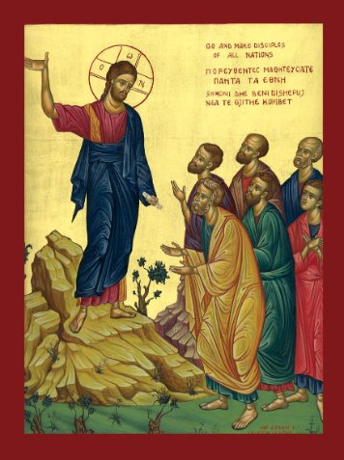
A Prayer to Begin
God of truth and love: Father, Son, and Holy Spirit, hear our prayer for those who do not know You. Make us witnesses of Your goodness, full of love, strength and faith–for Your glory and the salvation of the entire world. Amen.

Slide 3
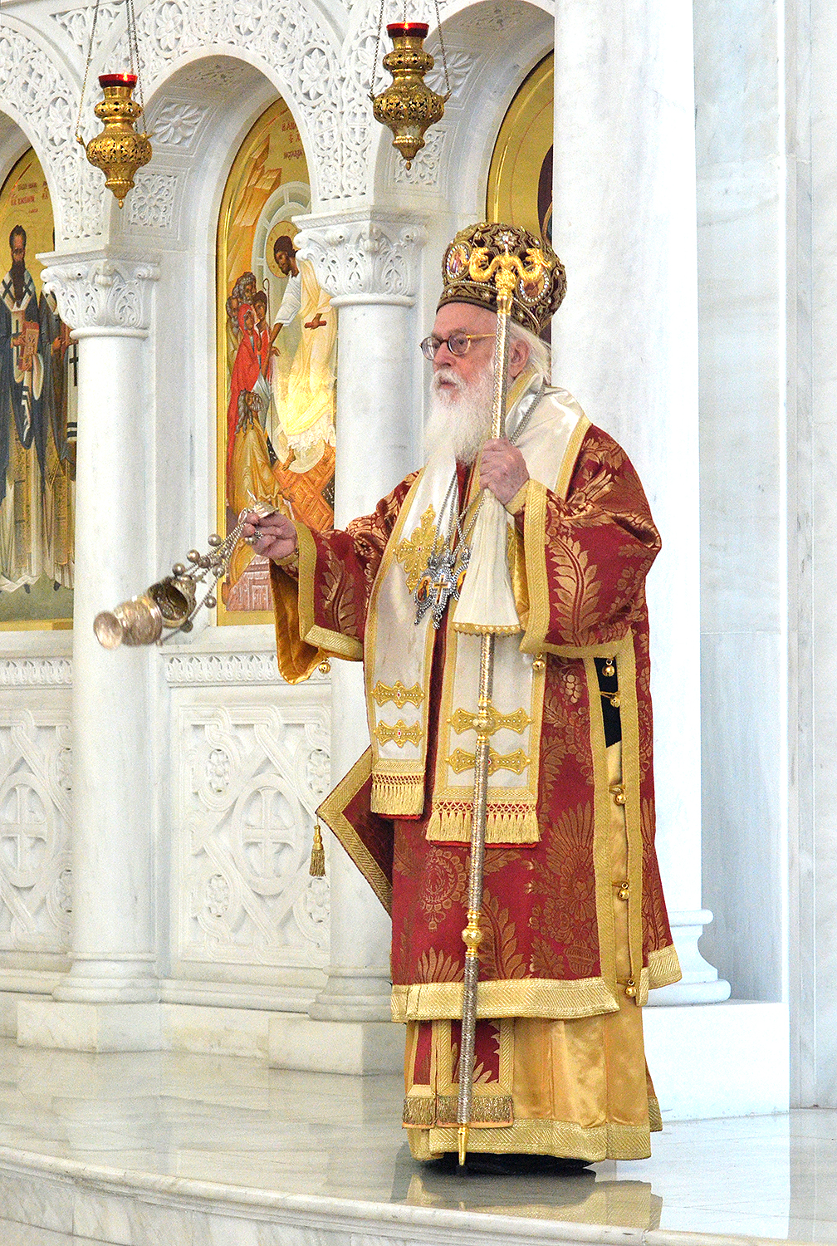
Before We Begin
When do you feel closest to God in your life?
What spiritual and physical needs did Jesus provide for people He met? ​
What is the Orthodox Christian’s responsibility to share spiritual light, bread, and water with the world? ​
Notes:
When do you feel closest to God in your life? (examples: in nature; when I feel accepted/valued, comforted; in mystery; etc.)​.
In the Gospels, Jesus is compared to physical, tangible necessities that can also be used as spiritual metaphors: light of the world, bread of life, and living water. Describe the spiritual needs that Jesus meets by comparing them to the physical needs in importance, urgency, etc. ​
What is the Orthodox Christian’s responsibility to share spiritual light, bread and water with the world? ​

Slide 4
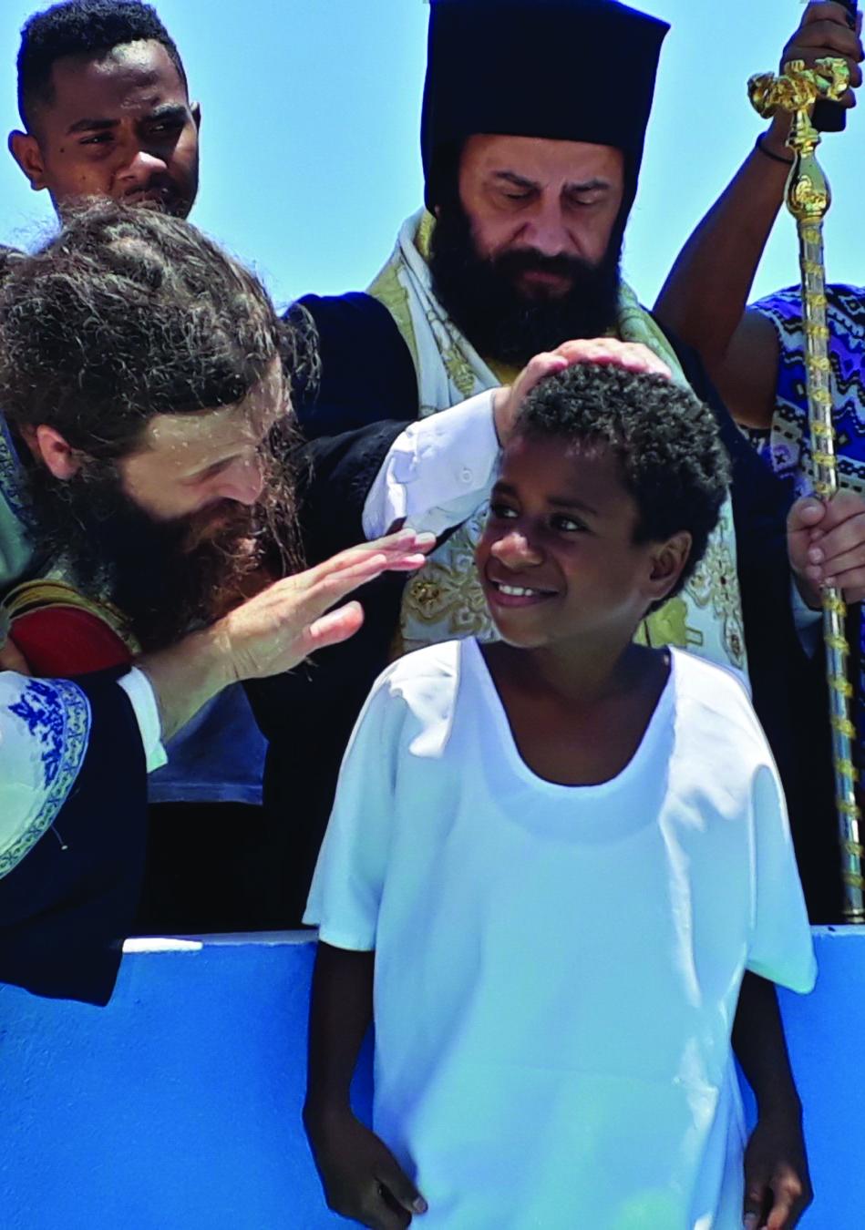
What does scripture Say about sharing our faith?
“As the Father sent me, so I also send you.”
– John 20:21​
“These things I have spoken to you, that my joy may remain in you, and that your joy may be full. This is my commandment, that you love one another as I have loved you.”
– John 15:11-12

Slide 5
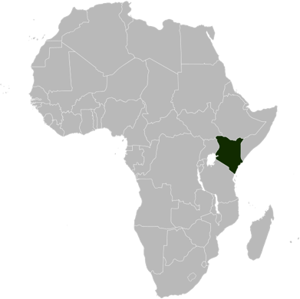
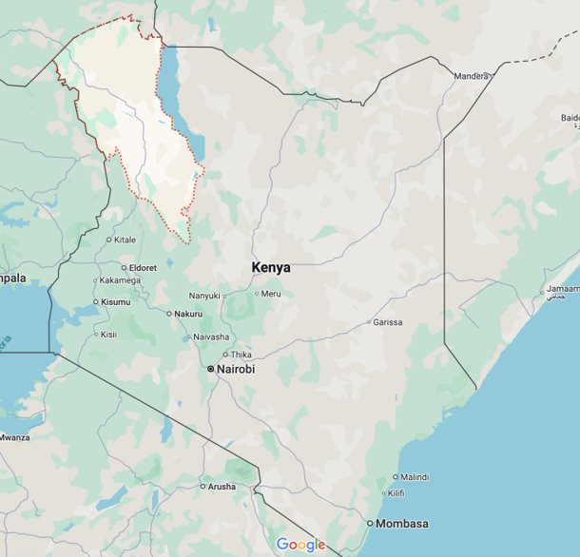
Who are the Turkana?
The Turkana people of northwestern Kenya are pastoral and nomadic, moving in search of water and grazing land for their herds. ​
Most had not heard of Jesus or the Christian message until the growing Orthodox Church of Kenya reached out to them. ​
​OCMC was invited to participate in this outreach in 2010.
Kenya
Turkana
Region

Slide 6
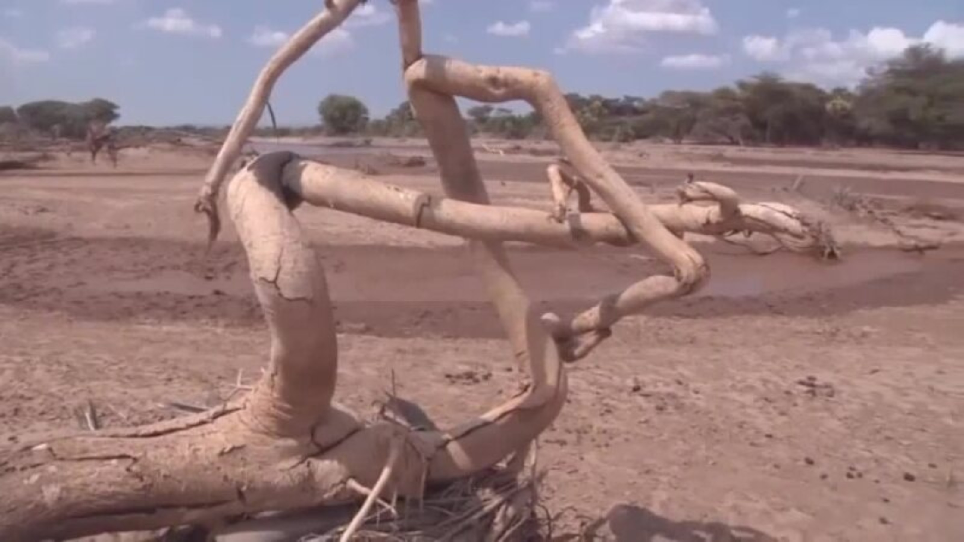
Notes:
OCMC overview video (approx. 4:40). Please note: There are other video modules available to show participants. They are posted on OCMC’s website (on the Download OCMC Materials page. Video topics include Becoming a Missionary, the SAMP Program, Grants & Proposals and Theological Training). If desired, select an additional video to show along with the Overview video.

Slide 7
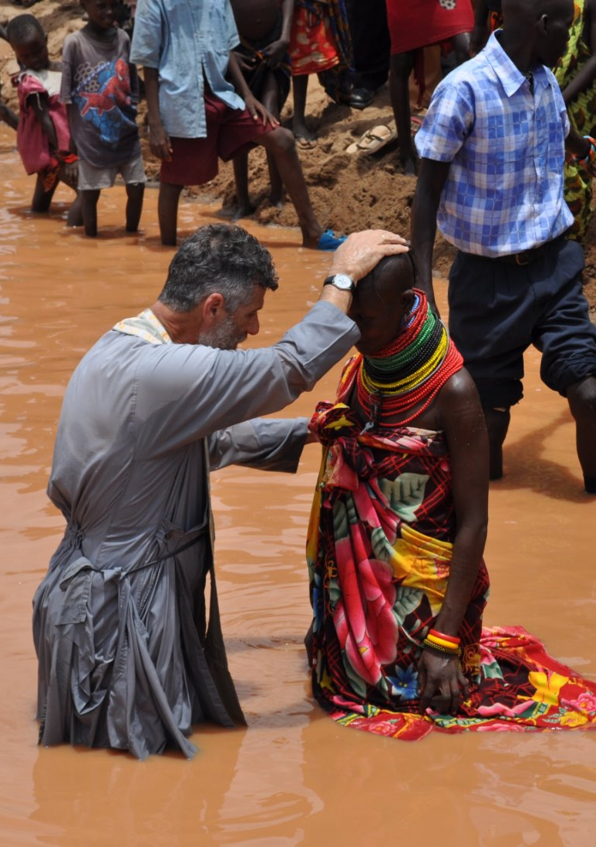
Video: Key Details
Water as a key part of the Turkana’s openness to the Gospel message​
​The shaman’s (spiritual leader of the village) openness to hear the Gospel message

Slide 8
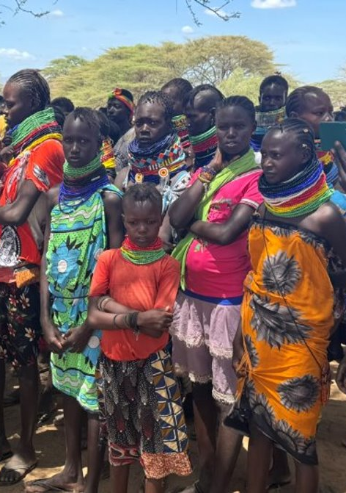
Discuss
Given that Jesus Christ is the “light, bread, and water”, how has the life of the Turkana people changed?
Spiritually? ​
Physically?​
Remember that Jesus always tied physical help and healings to spiritual help. People need both!

Slide 9
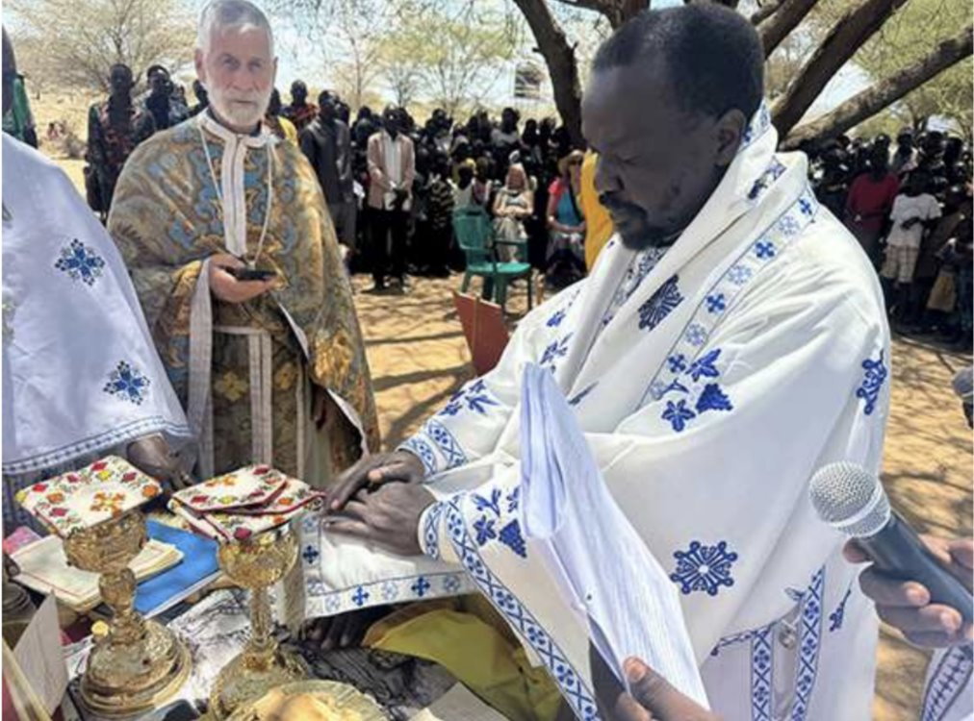
Orthodoxy in Turkana
Liturgy in Turkana, with His Grace Neofitos of Eldoret and Northern Kenya, and an OCMC team.
Notes:
Liturgy in Turkana, with His Grace Neofitos of Eldoret and Northern Kenya and an OCMC team. ​
Fr. Vladimir, who oversees four new Orthodox communities in Turkana, co-celebrated along with four other priests from Turkana.​

Slide 10
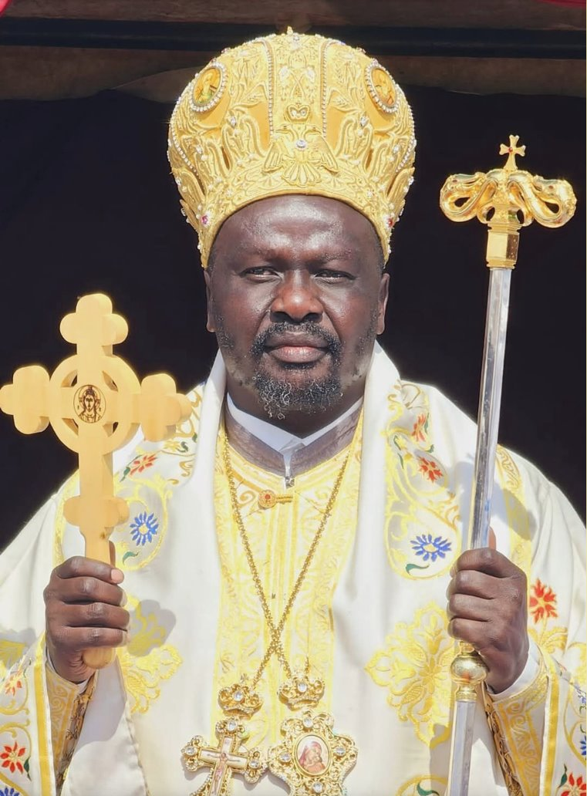
Orthodoxy in Turkana
​His Grace Bishop Neofitos ordained a new deacon as part of the celebration.
He likened this day in Turkana to the Day of Pentecost “where the Holy Spirit filled all things.”
Notes:
His Grace Bishop Neofitos ordained a new deacon as part of the celebration and about the first ordination in the Turkana district, he said: ​
“I chose to give the name of Gabriel for the new deacon because, like the Archangel Gabriel, he is always to bring the Good News of salvation of Jesus Christ to the people.”​
He likened this day in Turkana to the Day of Pentecost “where the Holy Spirit filled all things.”

Slide 11
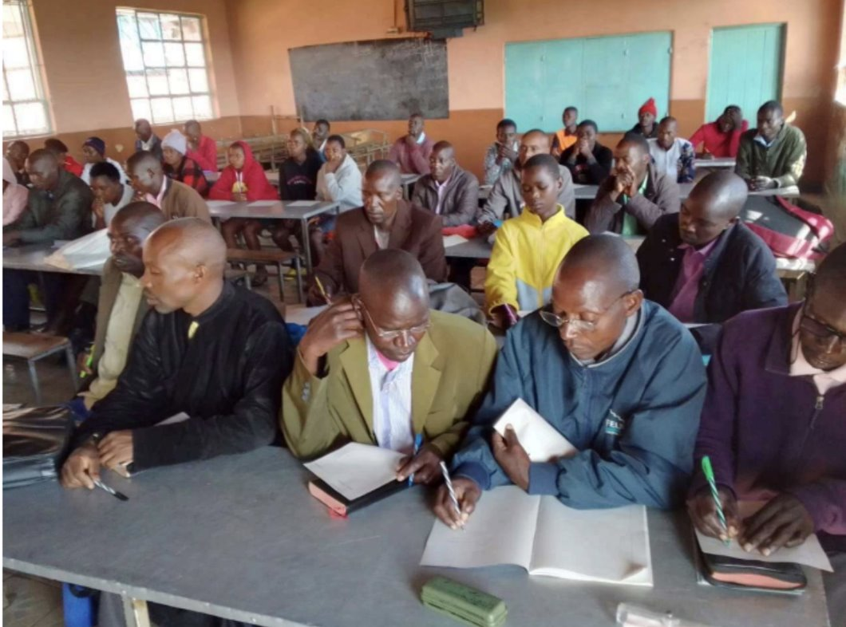
Orthodoxy in Turkana
Introducing Orthodoxy to 10 new villages ​
Training 15 lay catechists
Supporting through Mission Center grant
Notes:
Orthodoxy is now being introduced to 10 villages that have never heard the Gospel but want to know more. ​
15 catechists (one for each of these villages, plus 5 for the villages that have an Orthodox community) are meeting to receive intensive training, then going back to their villages to hold weekly reader’s services and catechize others. ​
This program is supported by a grant from the Mission Center that is enabled by the donations given by our partners in America.​

Slide 12
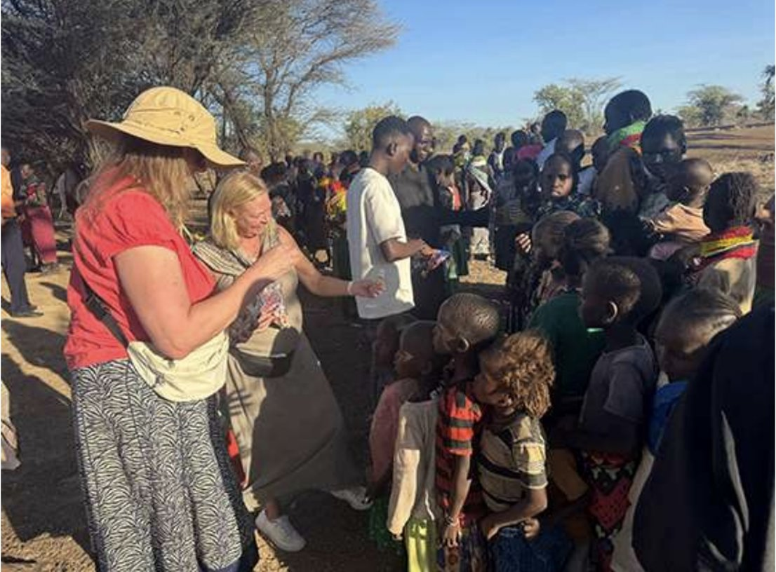
Orthodoxy in Turkana
Mission Center Activities:
assist seminaries
establish schools
dig wells
establish churches
Notes:
Orthodox Christian Mission Center mission teams have provided funds and practical help to assist seminaries, establish schools, dig wells, and establish churches.​
There is a need for theologically trained missionaries to aid in the training of catechists.​

Slide 13
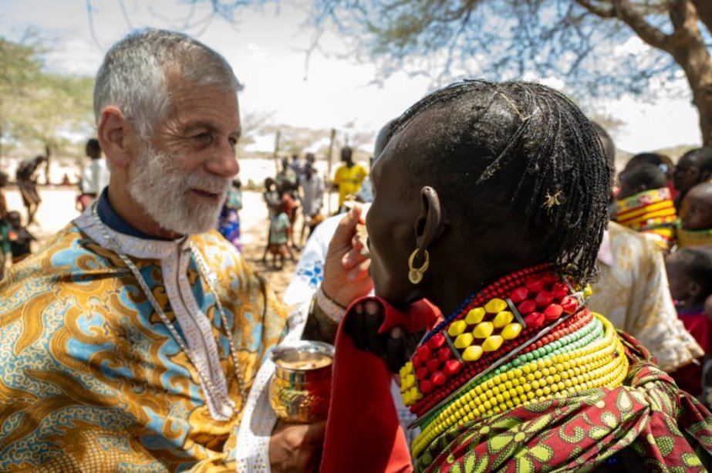
Discuss
What is our duty as Orthodox Christians to the rest of the world?
Who is my neighbor?
Luke 10:29

Slide 14
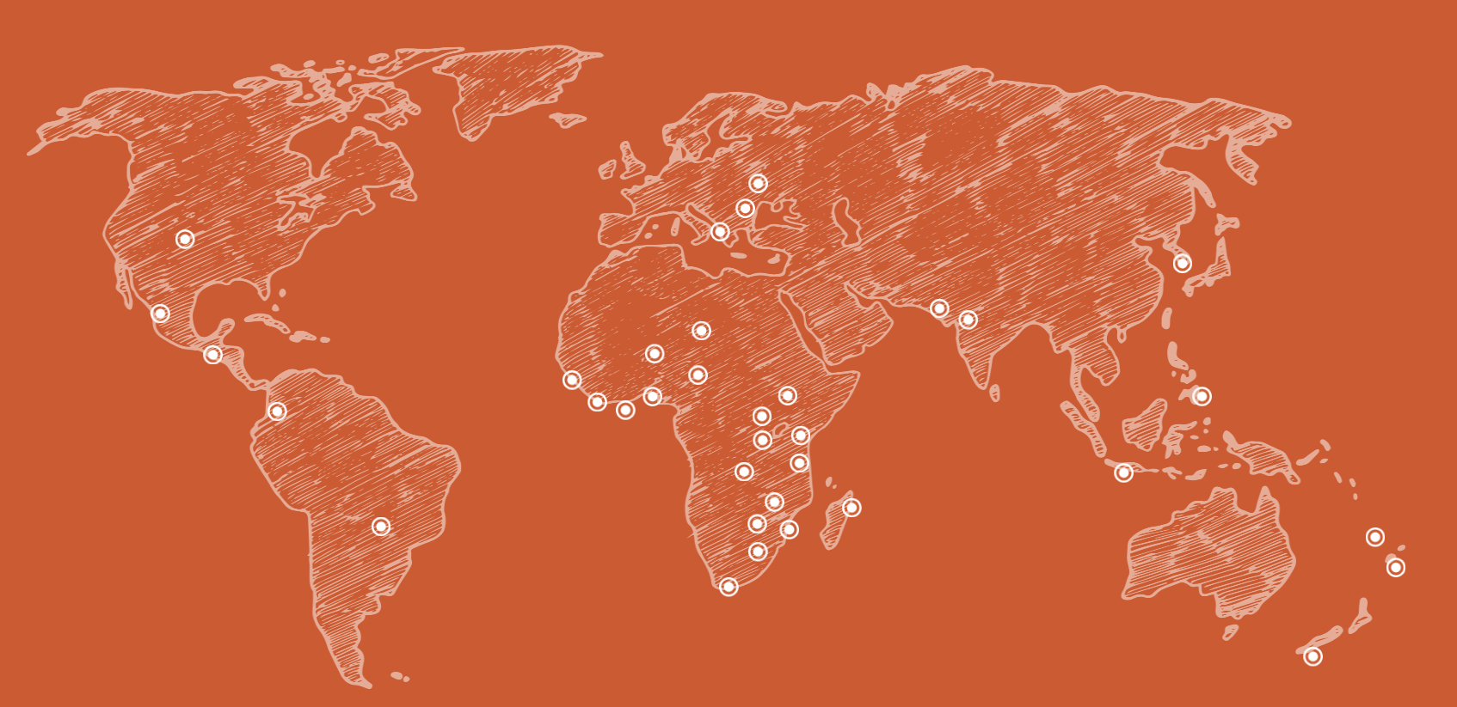
Where We Serve
The Gospel has
not been heard
The Church
has not been fully established
The population
is largely
non-Christian
We are currently active in
33 countries and 36 dioceses
Notes:
The Orthodox Christian Mission Center works to establish lasting relationships with Hierarchs and leaders in jurisdictions around the world. By opening and maintaining these pathways, we can identify and support missions in areas where:

Slide 15
Call to Action
What can you do to share your faith?
Pray for missionaries and catechists.​
Collect funds through OCMC coin boxes.
Host a missions-themed Fellowship Hour.​
Help with a local mission project.​
Bring a friend to church.​
Welcome visitors.
What other ways can you think of?
Notes:
What can you do to share your faith?
Lead the effort to support the work of Missions in your parish by praying for missionaries and catechists.​
Support the work of missions around the world by collecting funds through the OCMC coin boxes during Lent. ​
Host a Kenyan meal for a Fellowship Hour as a fundraiser for the work in Turkana.​
Help with a local mission project, e.g., local soup kitchen or outreach.​
Bring a friend to church (share your faith with your neighbor).​
Welcome visitors. Many new people are coming to our Church.​
What other ways can you think of to share your faith?

